Slide 1
AI, Robot
Interim Demo
James Hughes
C16379261
GitHub repo: https://github.com/JHughes135/InterimDemo

Slide 2
Interim Prototype
Game developed with Unity Engine
Player controlled human
City environment

Slide 3
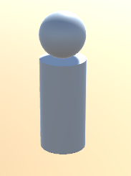
Player controlled Human
User controlled
Used to explore environment
Will not fly in final game

Slide 4
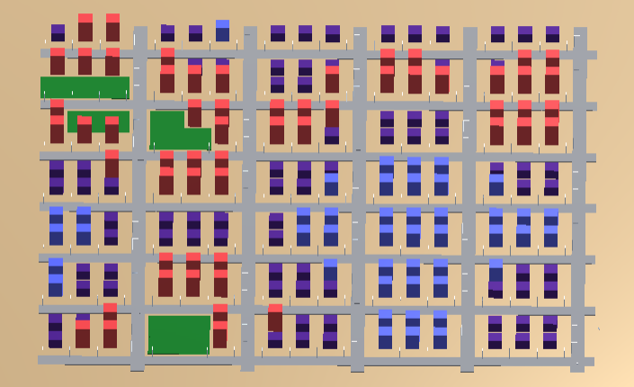
City Environment
Procedurally Generated
Grid is generated
Random number generated using Perlin noise
assigned to each grid
Streets laid out
Random number decides which building
is placed
3 different types of buildings
Grassy areas
Streetlights

Slide 5
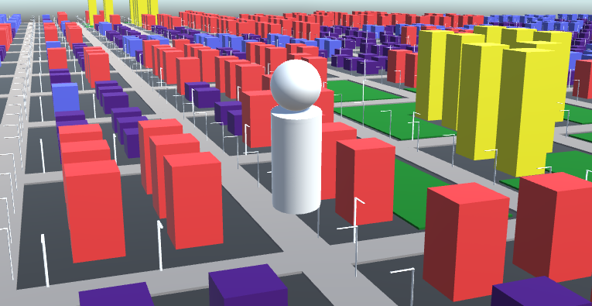

Slide 6
Final Game
AI self driving car
Player
City environment
Player will have to navigate environment to reach goal while completing objectives and avoiding AI cars

Slide 7
Future Requirements
Add AI self driving car
Unity NavMesh
Scripts
Add game aspects
Objectives for player to complete
Goal
Add textures to buildings and objects
Will create with blender

Slide 8
Why did I choose this project
Always been interested in games
Wanted to enjoy working on my project
Interested in AI

Slide 9
DEMO

